Slide 1
A Dynamic Longest Prefix Matching Content Addressable Memory for IP Routing
Author:
Satendra Kumar Maurya , Lawrence T. Clark
Publisher:
IEEE TRANSACTIONS ON VERY LARGE SCALE INTEGRATION (VLSI) SYSTEMS 2011
Presenter:
Ye-Zhi Chen
Date:
2012/09/19

Slide 2
Introduction
In this paper, an internet protocol content addressable memory (IPCAM) circuit that directly determines the longest prefix match to the stored address is described.
Entries need not be sorted in order.

Slide 3
Circuit Architecture

Slide 4
Circuit Architecture
Each entry in the proposed IPCAM match block directly computes the longest matching contiguous bits from a single stored address and mask word.
The number of table entries is reduced by up to 31 over the TCAM approach
The IPCAM entries need not be, and in fact cannot be sorted in match length order, since any entry can match from zero up to its mask length bits
The PE proposed here essentially sorts the match lengths output by the IPCAM circuit, forwarding the best ( longest ) value at each stage.

Slide 5
IPCAM Match Circuit
Match Groups
Match lines

Slide 6
IPCAM Match Circuit
Each IPCAM entry contains a single address, with seven segmented match lines labeled M(A-D)0–6 and four group match lines labeled(A-D)match
the leftmost column can discharge any of the eight match lines, but the rightmost can discharge only the topmost match line
The mask bits are set from left to right. For instance, if the prefix length is 24 bits, then group A is left out of the prefix search for that entry

Slide 7
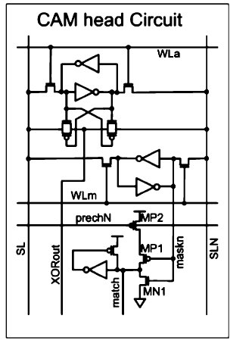
IPCAM Match Circuit
The column-wise XOR network in the CAM head cell determines if the stored address bit matches the incoming address bit for that column.
If it does not, signal XORout is asserted high.

Slide 9
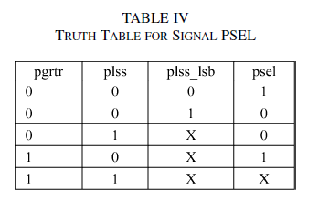
Priority Encoder Architecture

Slide 10
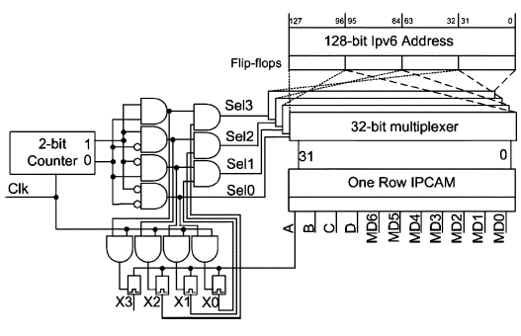
Extension to IPv6
A more efficient IPv6 implementation employs a single 32-bit IPCAM matching circuit, driven by four 32-bit data and mask memory registers

