Slide 1
Deterministic and Efficient Hash Table Lookup Using Discriminated Vectors
Author: Dagang Li, Junmao Li, Zheng Du
Publisher: GLOBECOM, 2016 IEEE
Presenter: Yi-Hao Lai
Date: 2016/02/15
Department of Computer Science and Information Engineering
National Cheng Kung University, Taiwan R.O.C.
Notes:
1

Slide 2
Introduction
Hash table is prevalently used in various fields of networking such as route lookup, packet classification, perflow state management and network monitoring as it can achieve O(1) latency for query, insert and delete operations at moderate loads.
However, measures like chaining and linear probing will have to be taken to solve the collision problem at the cost of additional memory access when the load of the hash table increases. Thus, the lookup latency becomes uncertain, which poses threats to some time-critical systems.

Slide 3
Introduction
achieve O(1) average memory access per lookup.
perform lookup operation with a single access to the off-chip memory.
support highly loaded hash table.

Slide 4
Cuckoo hashing
The load ratio of Cuckoo hash table can be up to 0.9 without collision with 3 independent hashing functions. When performing the lookup operations, Cuckoo hashing requires one memory access for each hash function respectively to determine which one of its candidate slots actually stores the element.
If we can foresee which hash function corresponds to the actual slot where the element is stored in the Cuckoo hash table, the memory access will be cut down to a single one while keeping the load ratio unchanged.

Slide 5
DEHT
In this paper, we design such a deterministic and efficient hash table scheme called DEHT that can minimize access to the off-chip Cuckoo hash table.
Notes:
capable of running a 64bit Linux operating system

Slide 6
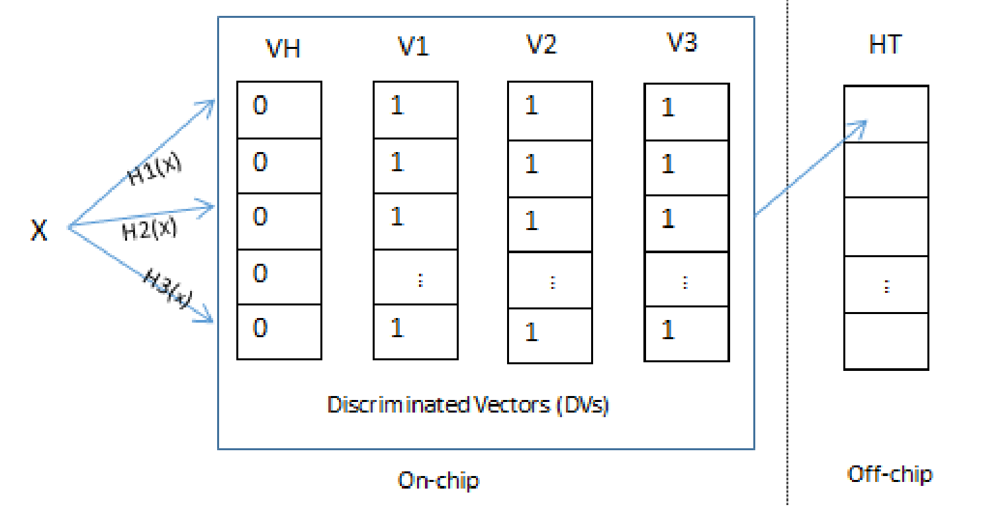
DEHT
The data structure of DEHT
an off-chip Cuckoo hash table with k hash functions
k+1 discriminated vectors (DVs) on the on-chip memory

Slide 7
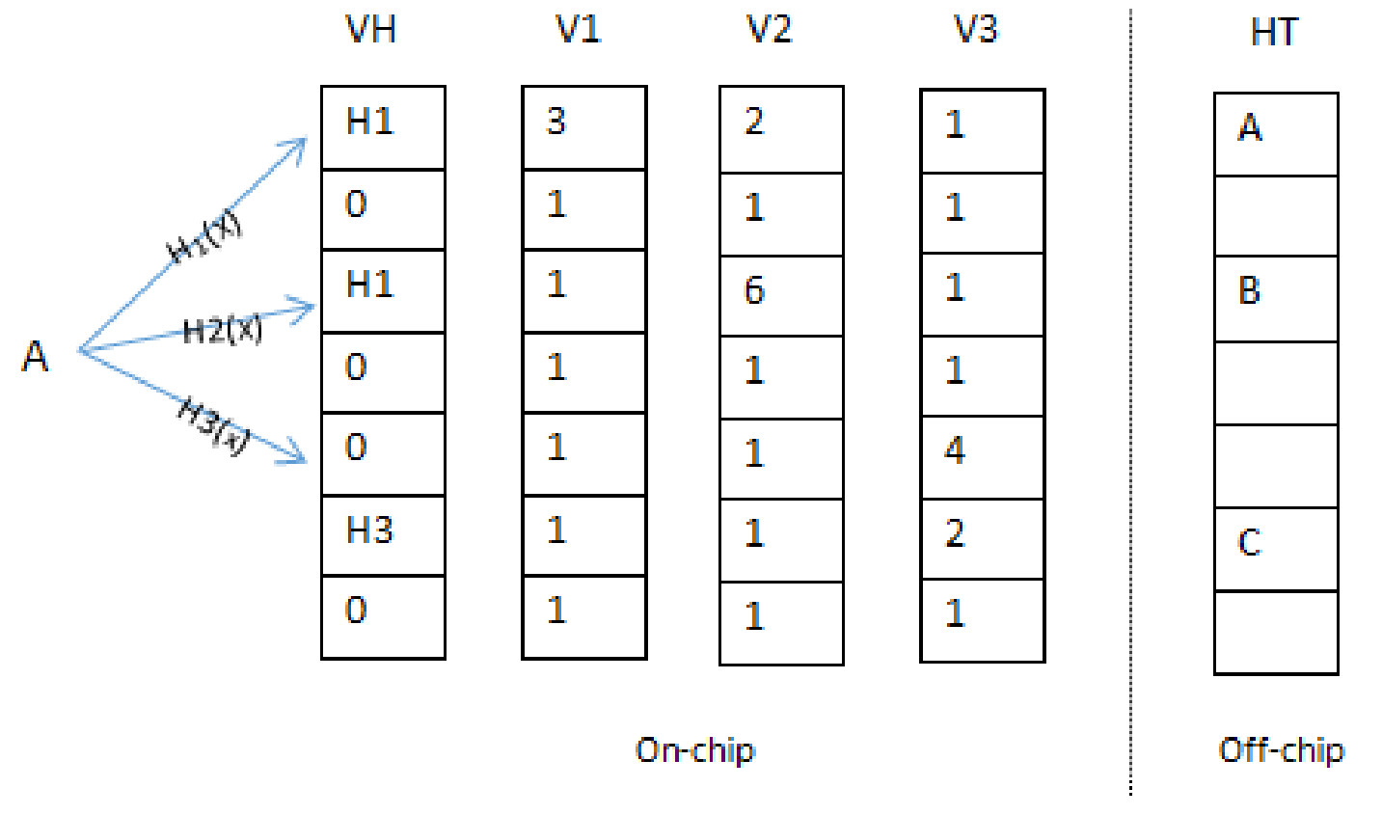
Lookup
Lookup item A
H1(A)=0, H2(A)=2, H3(A)=4
Check minimum of V1[0], V2[2], V3[4]

Slide 8
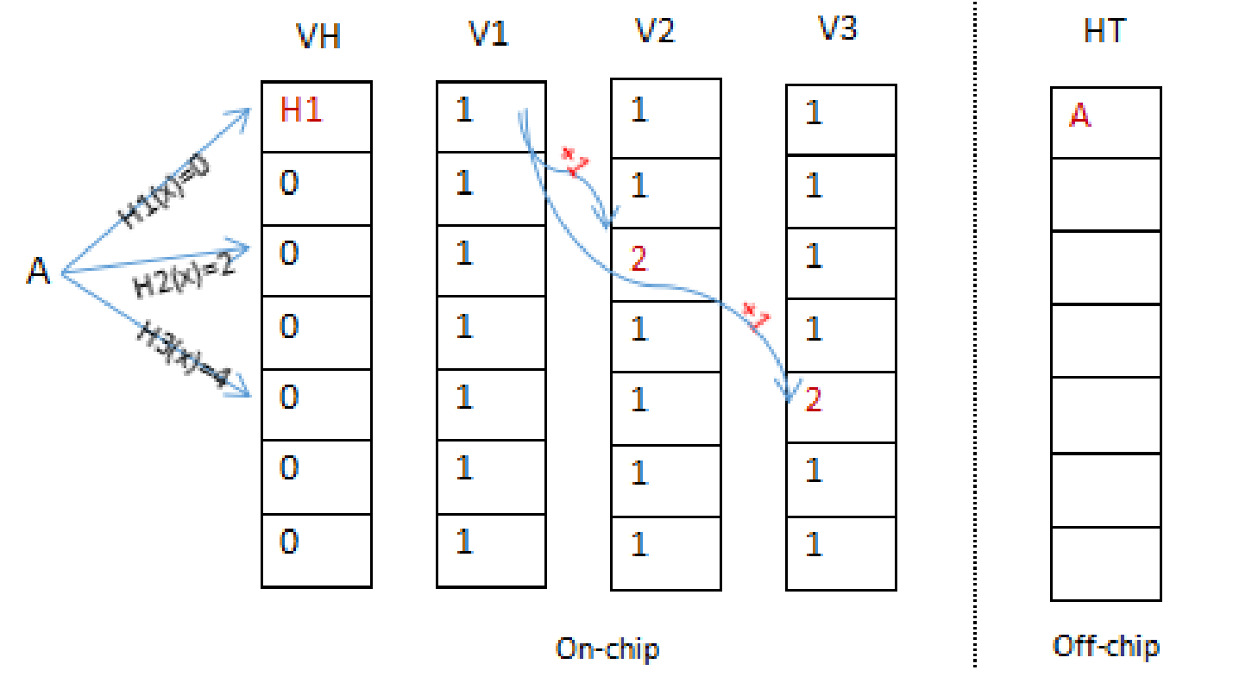
Insertion
Insert A

Slide 9
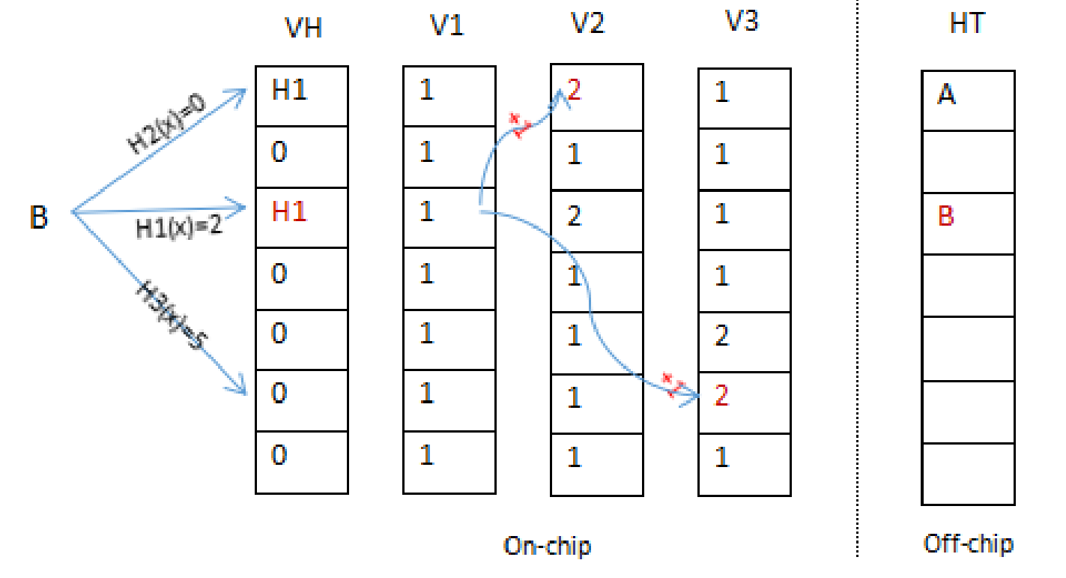
Insertion
Insert B

Slide 10
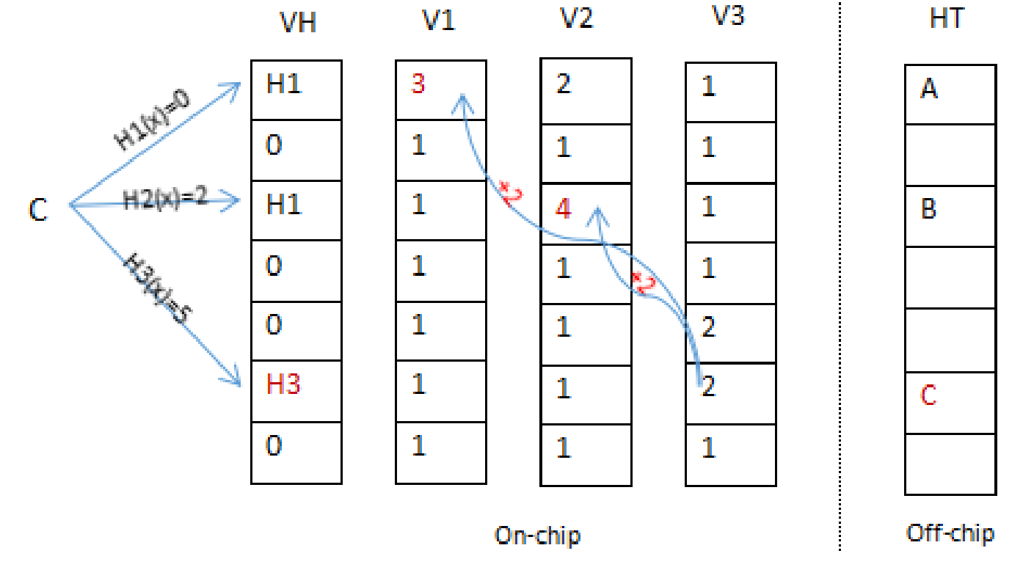
Insertion
Insert C

Slide 11
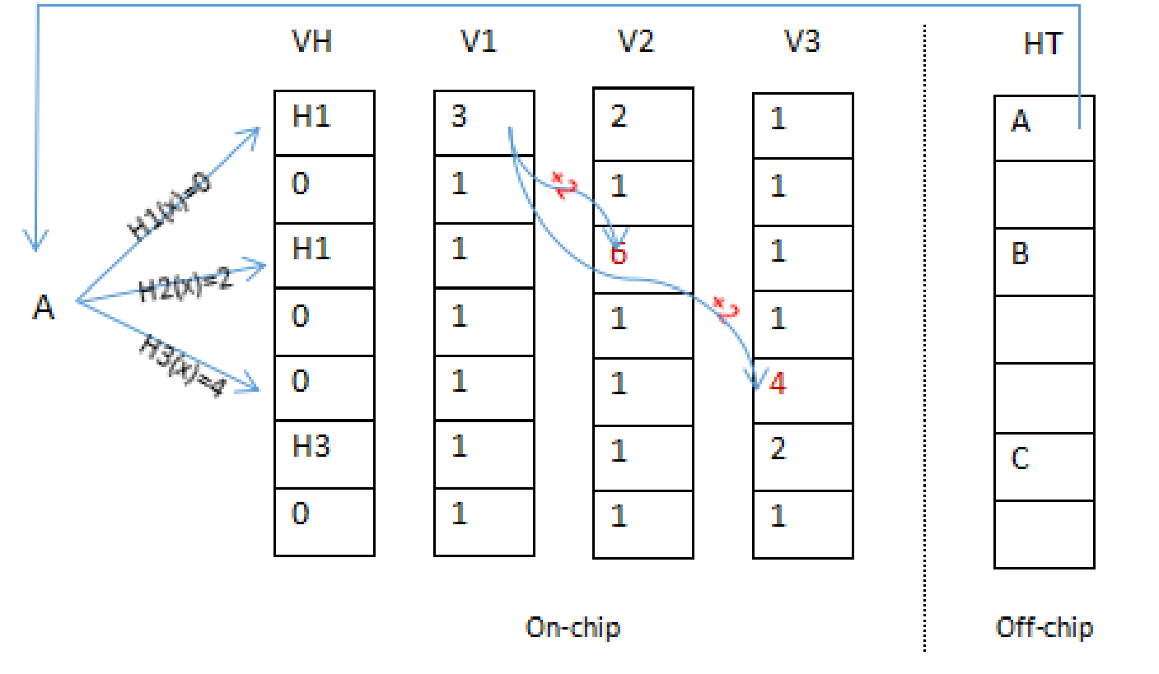
Insertion
Insert C

Slide 12
Complexity Analysis
The lookup operation needs to compare 3 values and output the minimum one on-chip. And then a value from the off-chip hash table will be fetch accordingly. So the total complexity of lookup is O(1) and the off-chip memory access is 1 at most.

Slide 13
Complexity Analysis
As for the delete operation
t = (k - 1) + (k - 1) * $\frac{1}{k+1}$ t
t = $\frac{\left(k−1\right)(k+1)}{2}$
Because k is a fixed number ranging from 2 to 4 in most situations, so the on-chip complexity is also O(1).

Slide 14
Complexity Analysis
When inserting an element, if any of the candidate slots of the hash table is empty, the on-chip time complexity O(1) similar to that of delete operation.
However, if all candidates slots are occupied, one of them need to be moved to another slot to make room for the current inserted one and the relocation may be recursive.
The time complexities of on-chip and the whole insert operation are equal to the ordinary Cuckoo hashing.

Slide 15
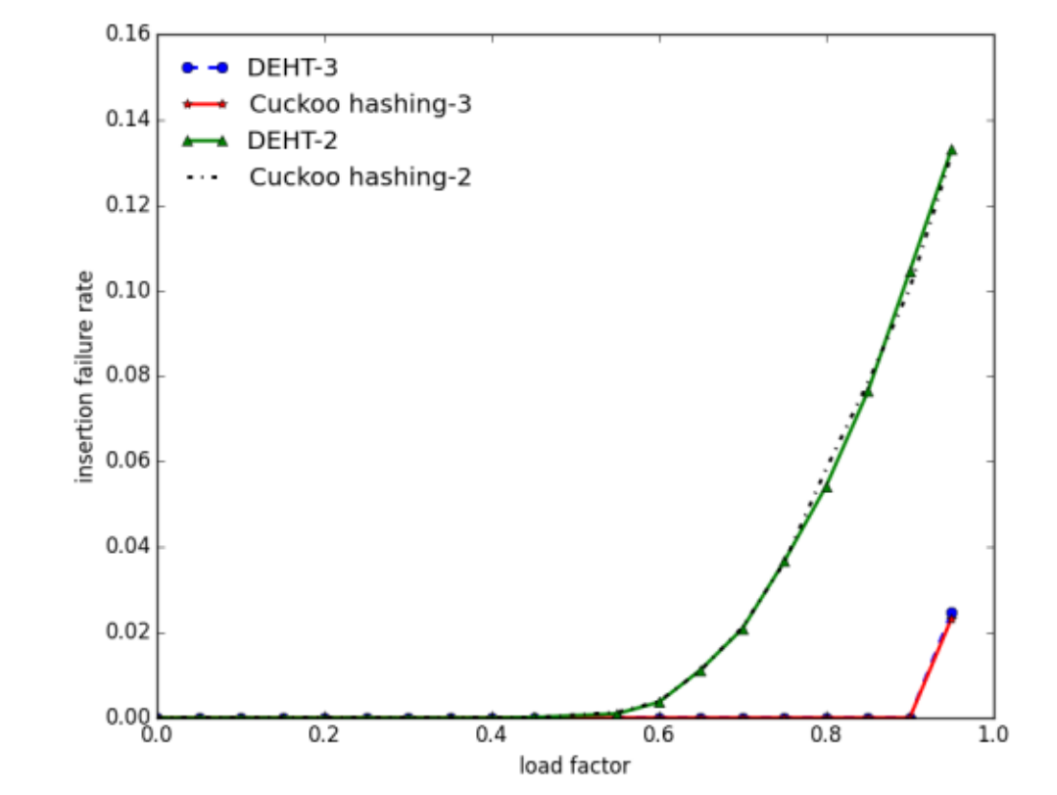
Performance analysis
Memory Efficiency Analysis

Slide 16
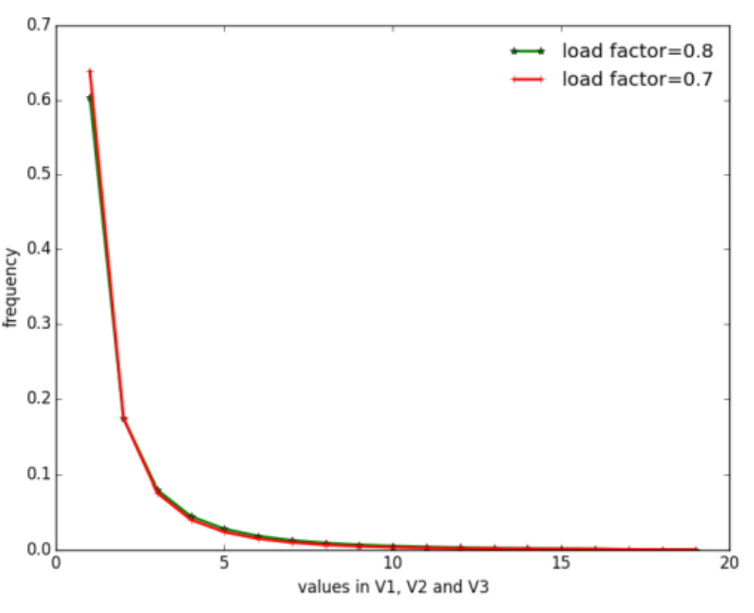
Performance analysis
In every slot of VH there are 4 possible values, so 2 bits are enough for the slots of VH.
the memory cost of each of V1, V2 and V3 will be
Cost(n) = 2n + 2n * $\frac{1}{10}$ + 2n * $\frac{1}{100}$ + … = $\frac{20}{9}$ n
total memory cost
3 * $\frac{20}{9}$ n + 2n = $\frac{26}{3}$ n
Notes:
We find that the cumulative frequency of the values 1-4 and 1-8 are 0.93 and 0.99 respectively and the vast majority of them are very small integers.

Slide 17
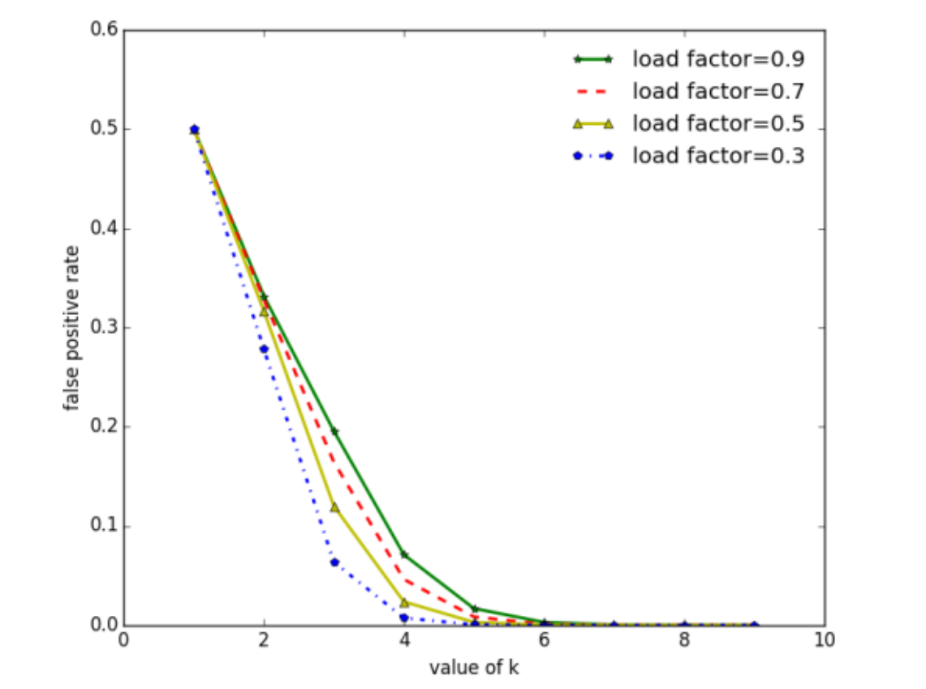
Performance analysis
False Positive Rate Analysis
tot = $\frac{\left(k−1\right)(k+1)}{2}$, p = ${(1 − \frac{tot}{km})}^{n}$
fpr = $\frac{1}{k+1}$ [${(1 −p)}^{k}$ + ${kp(1 −p)}^{k−1}$]
Notes:
And in the case of 3 hash functions or k=3, the fpr is always smaller than 0.18 which are trivial compared to other methods.

Slide 18
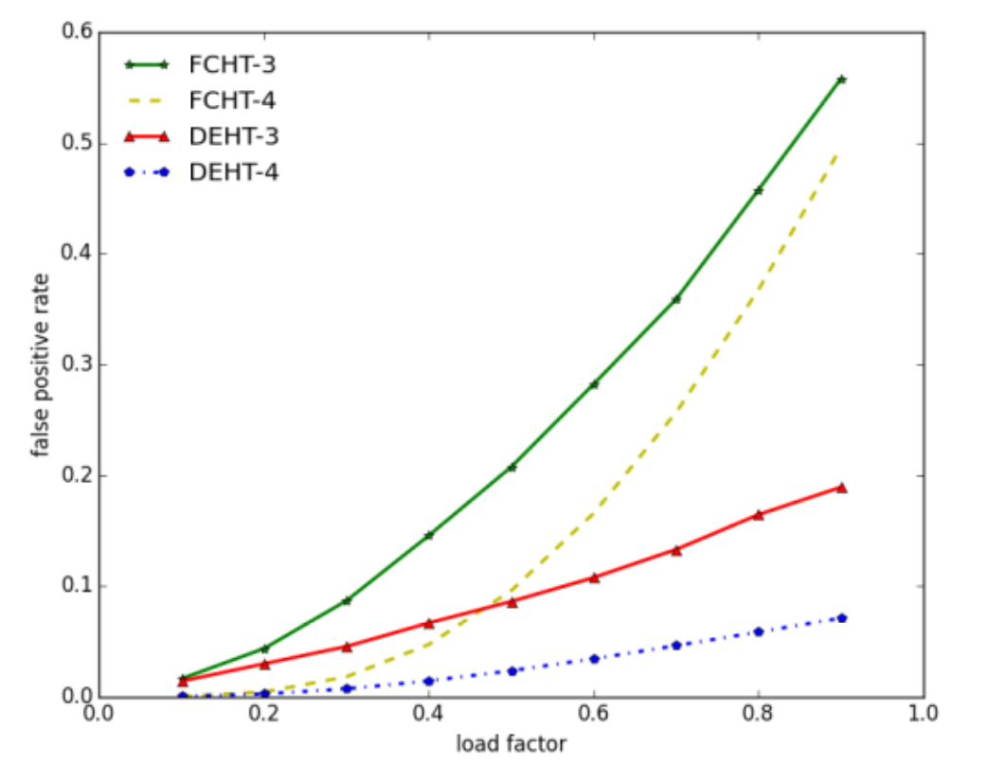
Experimental analysis
False positive rate

Slide 19
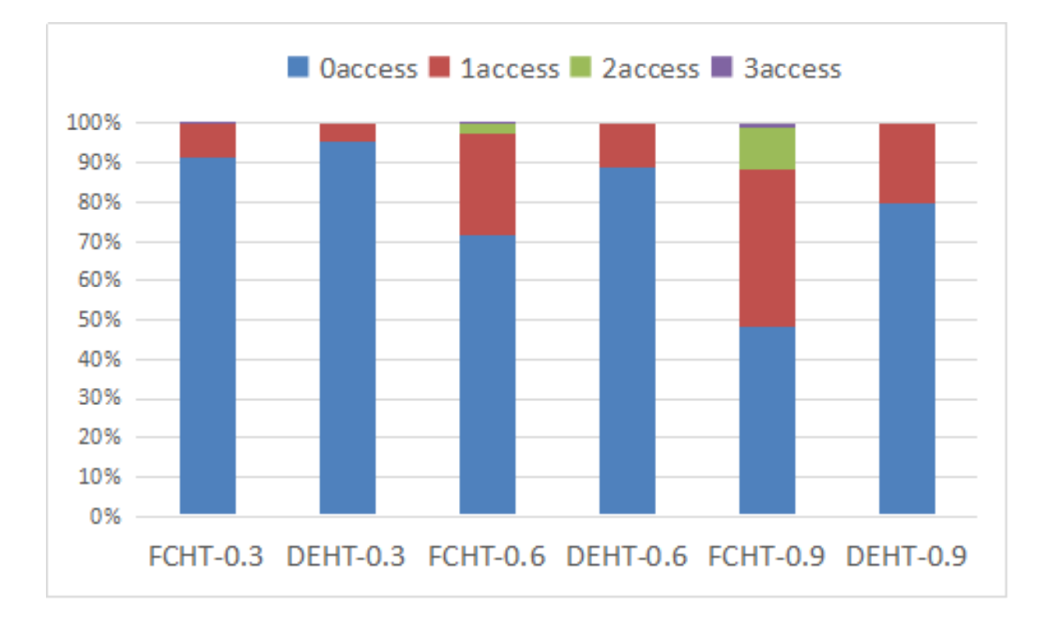
Experimental analysis
Off-chip memory accesses (random input)

Slide 20
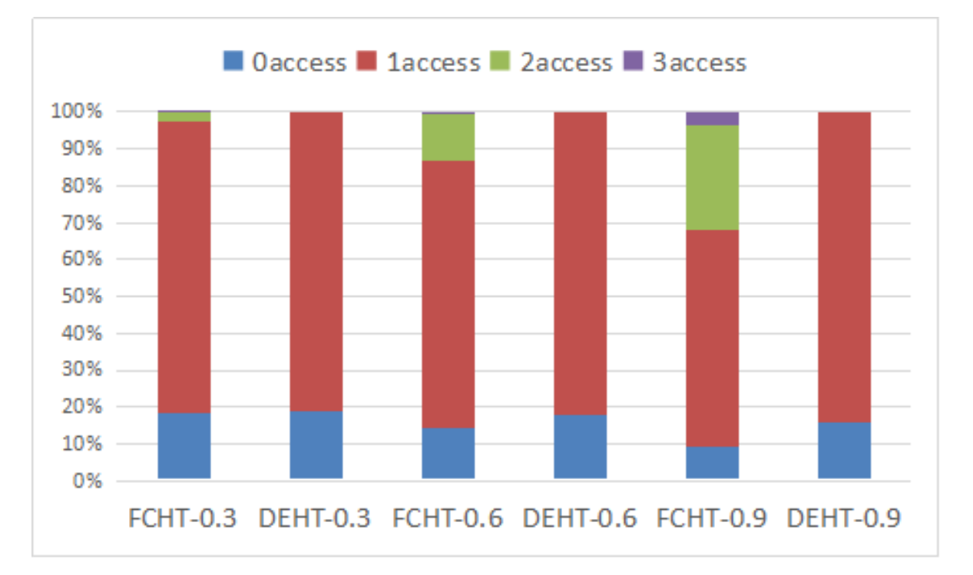
Experimental analysis
Off-chip memory accesses (80% true element)

