Slide 1
AVANT-GUARD: Scalable and Vigilant Switch Flow
Management in Software-Deﬁned Networks
Author: Seungwon Shin, Vinod Yegneswaran, Phillip Porras, Guofei Gu
Publisher: 20th ACM Conference on Computer and Communications Security

Slide 2
Cons
First, OpenFlow networks lack scalability between the data and control planes.
OpenFlow offers very limited support for network monitoring applications that seek a ﬁne-grained tracking of operations at the data plane

Slide 3
We propose a strategic and focused extension to the data plane called connection migration that we argue yields the signiﬁcant beneﬁt of halting the threats of the saturation attack. To the best of our knowledge, connection migration is the ﬁrst attempt in this direction to be embedded into an SDN network.
We propose a new technique called an actuating trigger that addresses the responsiveness challenge by providing condition-triggered push capability in SDN devices.
We design and implement AVANT-GUARD to integrate both connection migration and actuating triggers in a reference SDN (OpenFlow) software switch.

Slide 4
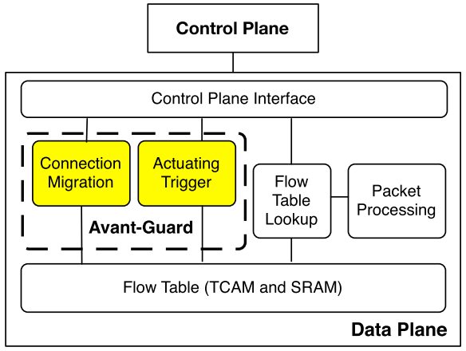

Slide 5
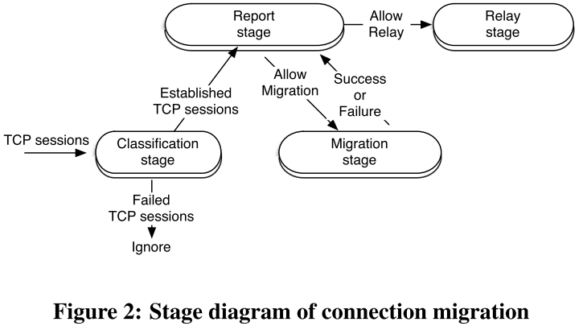
Connection Migration

Slide 6
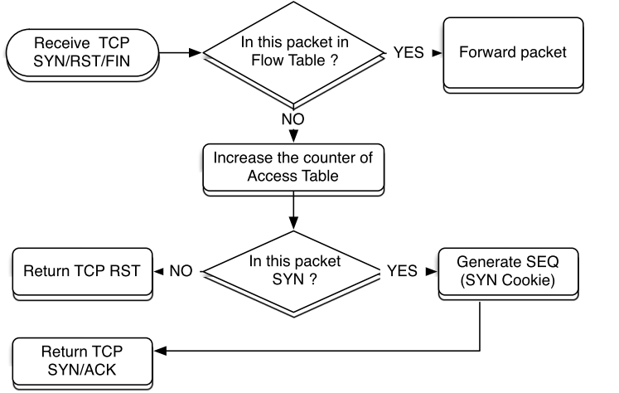

Slide 7
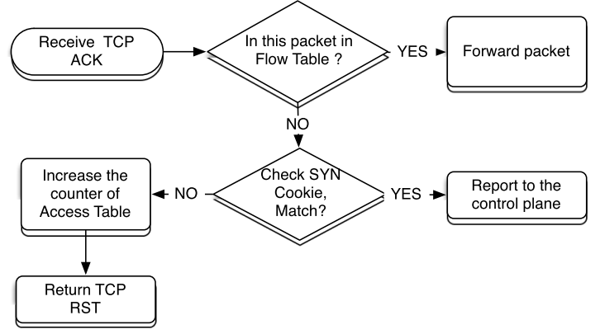

Slide 8
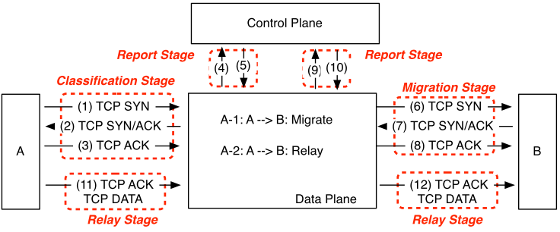
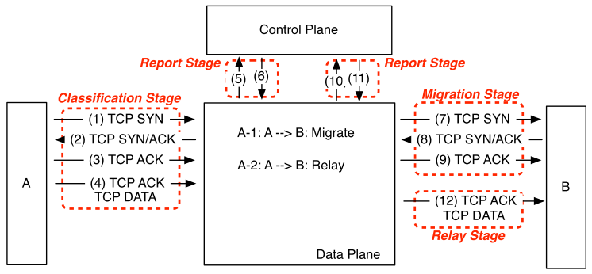

Slide 9
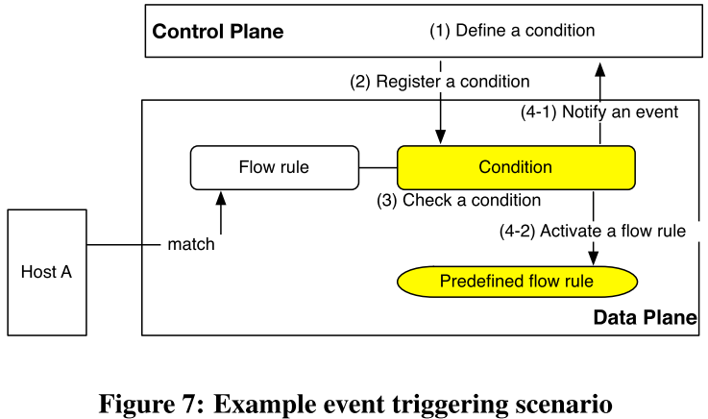

Slide 10
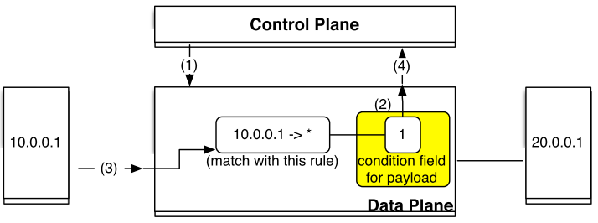
{type: condition: pointer}
Payload-based 2bit 1bit

Slide 11
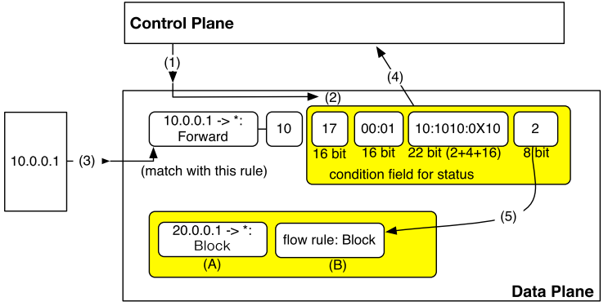
{type: condition: pointer}
Payload-based 2bit 2bit 4bit 16bit
01 time-related metrics options valus

Slide 12
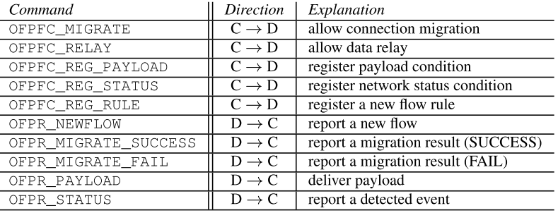

Slide 13
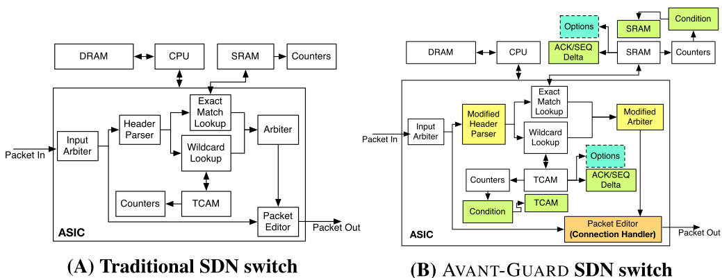

Slide 14
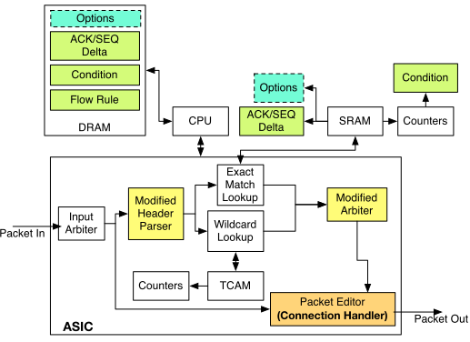

Slide 15
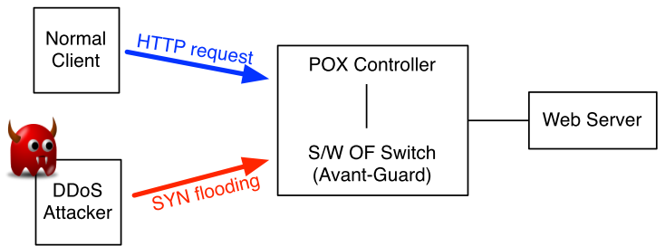
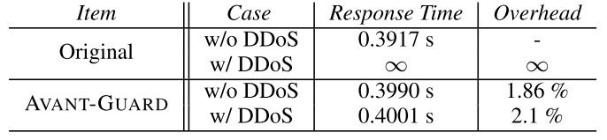

Slide 16
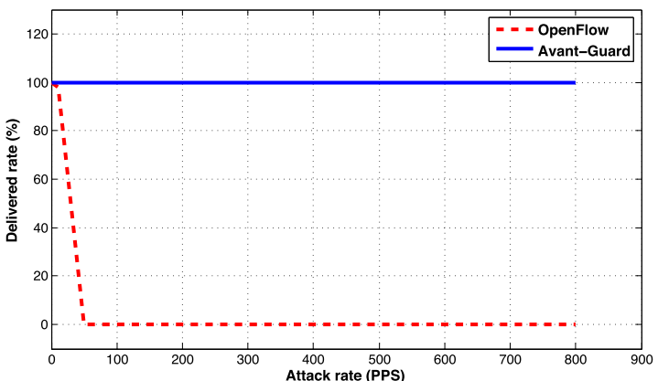

Slide 17
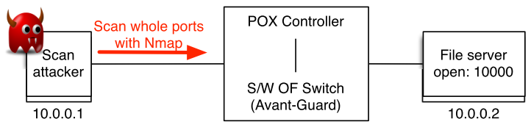
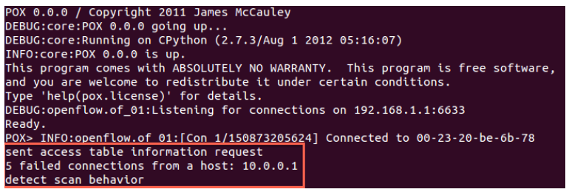

Slide 18
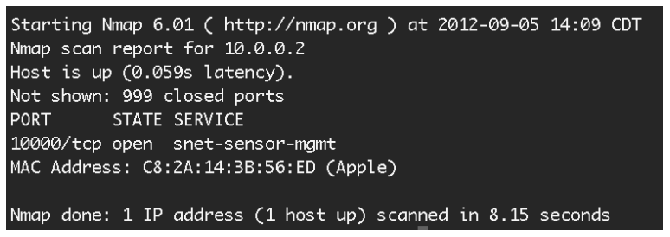
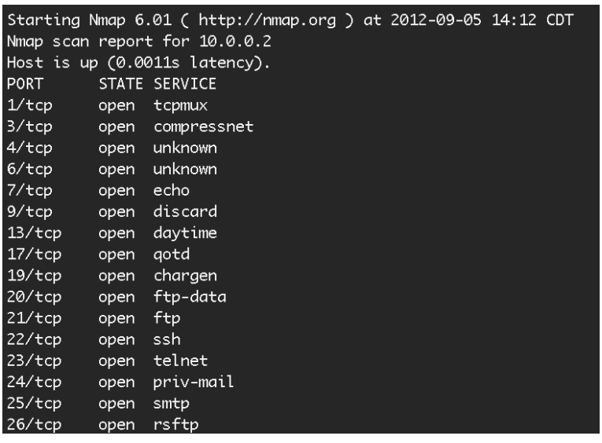

Slide 19
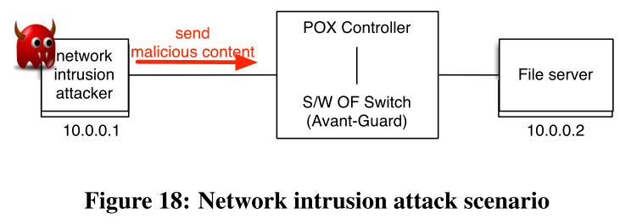
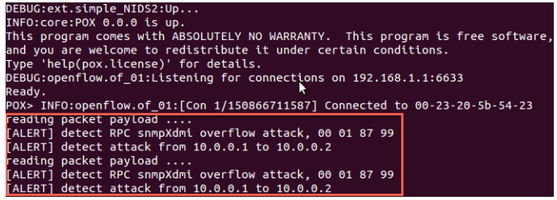

Slide 20
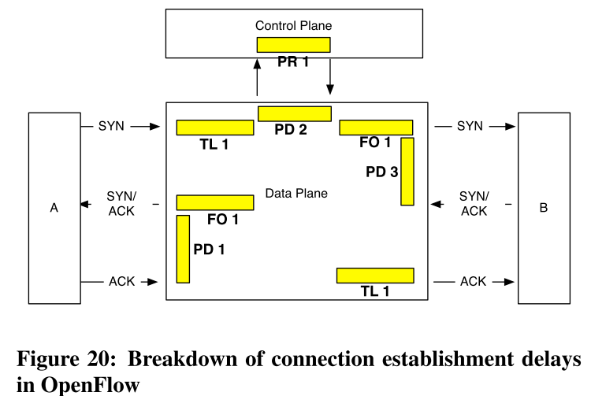
(i) lookup a ﬂow table and forward (TL1);
(ii) ask thecontrol plane for a ﬂow rule and receive the rule (PD2) - (processing
time in the control plane (PR1) is not included);
(iii) insert a ﬂow rule and forward (FO1);
(iv) receive a SYN/ACK packet (PD3);
(v) forward a packet based on the ﬂow
rule (FO1);
(vi) receive anACK packet (PD1);
(vii) lookup a table and forward (TL1).

Slide 21
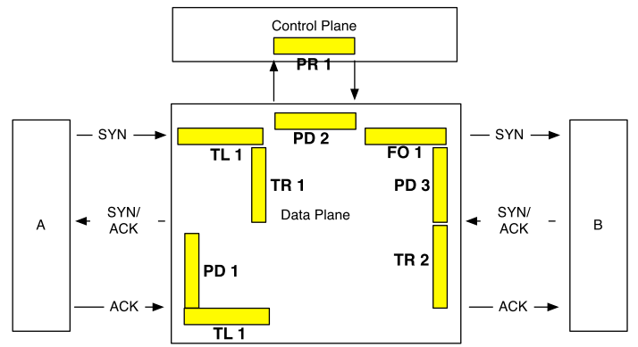
(i)lookup a ﬂow table and forward (TL1);
(ii) generate a SYN/ACK packet (TR1);
(iii) receive an ACK packet (PD1);
(iv) lookup the ﬂow table (TL1);
(v) ask the control plane to get a permission for migration and receive the rule for migration (PD2) - (processing time in the control plane (PR1) is not included);
(vi) forward a SYN packet to a target host (FO1);
(vii) receive a SYN/ACK packet (PD3);
(viii) generate an ACK packet and send it (TR2).

Slide 22
OpenFlow case = TL1 + PD2 + FO1 + PD3 + FO1 + PD1 +TL1
AVANT-GUARD case = TL1 + TR1 + PD1 + TL1 + PD2 +FO1 + PD3 + TR2
Origin: 1608.6 us; for AVANT-GUARD 1618.74 us. overhead 0.626%
Origin: 32.4 us; for AVANT-GUARD 42.54 us us. overhead 23.84%

Slide 23
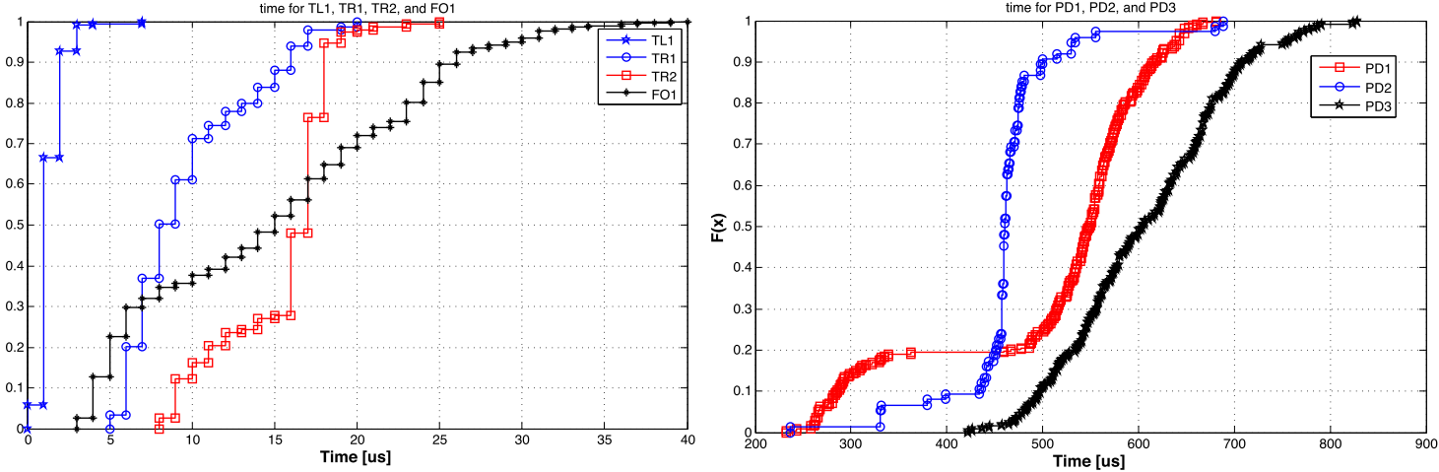

Slide 24
